Slide 1

SpotOn
Aryan Jha
Heyab Robel
Benny Enriquez
Carl Hiram Yaro

Slide 2
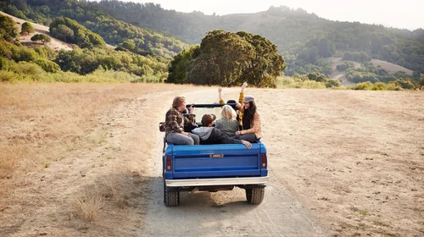
Vision

Slide 3

Vision

Slide 4
DEMO 1

Slide 5
DESIGN

Slide 6
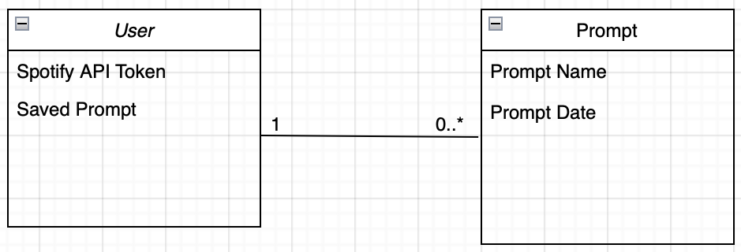
Domain Model

Slide 7
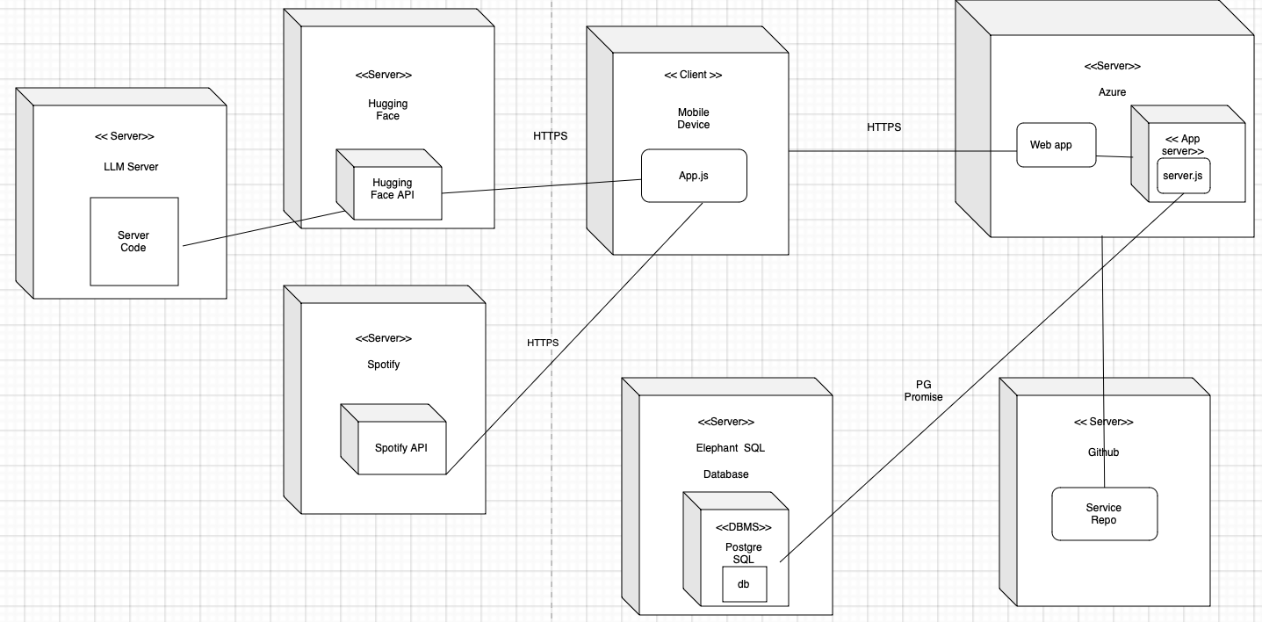
Deployment Diagram

Slide 8
Assessment

Slide 9
Functionality

Slide 10
Future Prospects

Slide 11
Social Implications

Slide 12
Postman’s 1st Idea

Slide 13
Postman’s 5th Idea

Slide 14
Questions
https://open.spotify.com/track/0JN40O1Z4jRnRloJe6IKTT

Slide 15
Thank You!

